Slide 1
EMBEDDED SYSTEM DESIGN PROJECT ESE-4009 Interfacing DC MOTOR with beaglebone black
Submitted by: HARMANDEEP SINGH (C0751299)
(Group 2)

Slide 2

List Of content
Project Introduction
Task Introduction
Tool Requirements
Hardware Setup
Description of connections
Software part
Results
conclusion
References

Slide 3
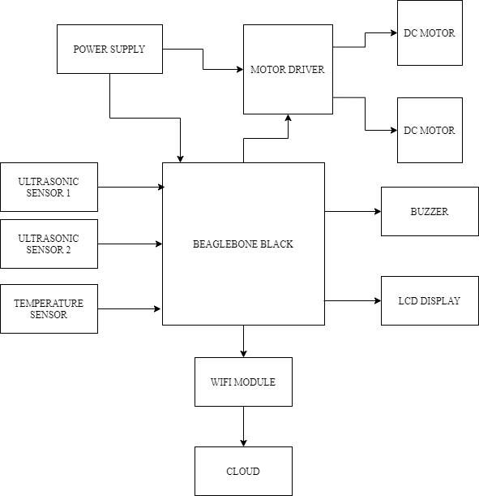
IoT based Visitor Counter using Beaglebone Black

Slide 4
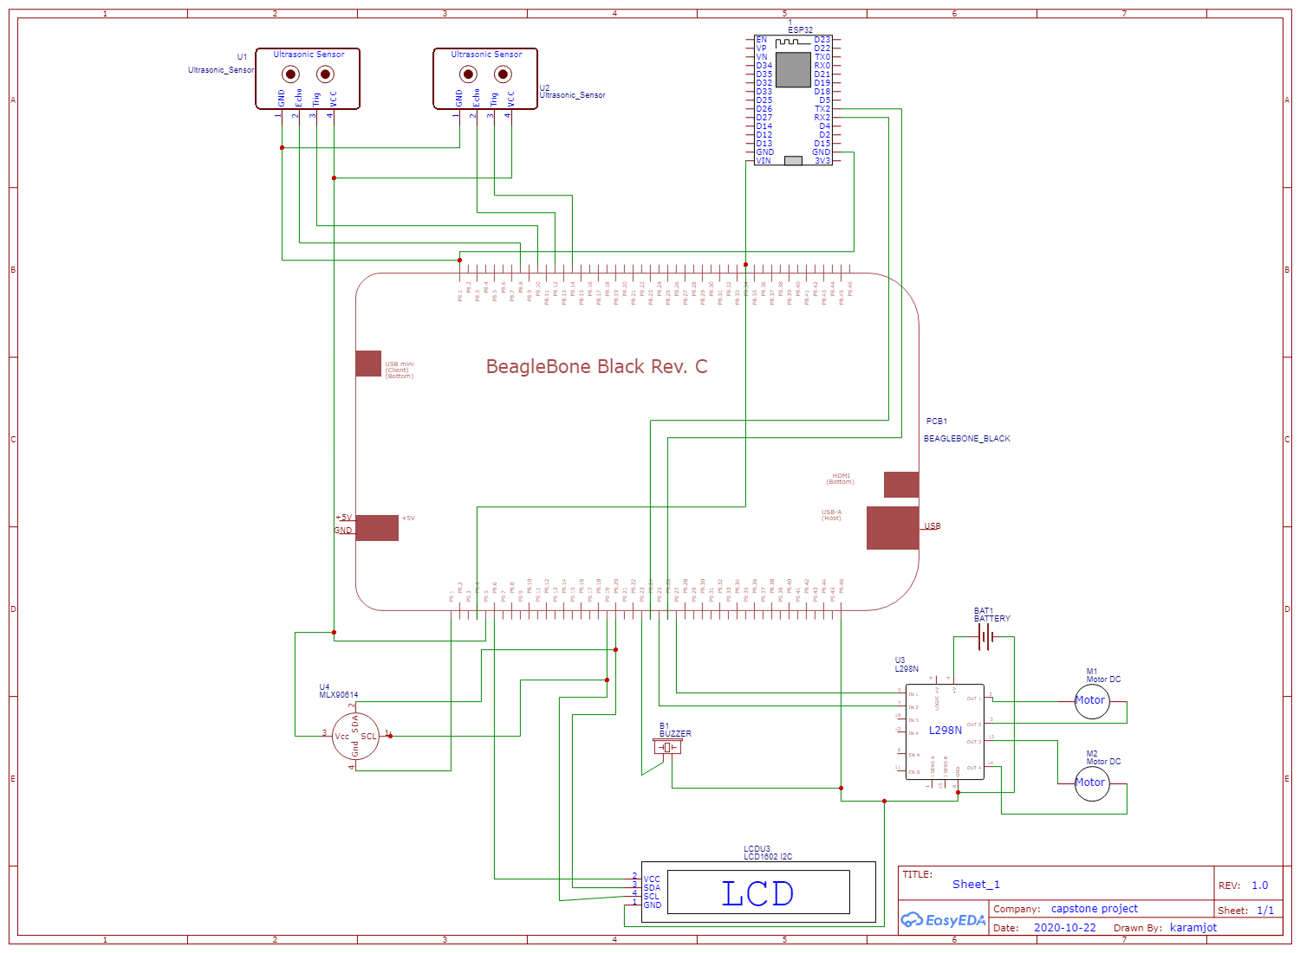
Schematic Diagram of the Project

Slide 5
Task Introduction
This task is about interfacing DC motor with Beaglebone black.
Here, Two 12v 10RPM DC motors are used to control Entry and Exit doors.
L298N Motor Driver is used to control the motors.
Ultrasonic sensors are also used in this interfacing to let the motor know when to open the exit and entry doors.
The upcoming slides will explain about the connections and all the hardware and software used to accomplish this task.

Slide 6
Components Required for Interfacing
HARDWARE
Beaglebone Black
Ultrasonic sensors (2)
DC Motors (2)
Motor Driver (L298N)
Power supply
Breadboard
Wires
SOFTWARE
PUTTY
Eclipse IDE
WINSCP
Debian OS (BeagleBone Black)
Nano Editor

Slide 7
Beaglebone black
Beaglebone is compact, low-cost, open-source Linux computing platforms that can be used to build complex applications that interface high-level software and low-level electronic circuits.
This is the main microcontroller used in this project.
For this task GPIO pins of beaglebone black are used.
The library to access these GPIO pins is also installed which is “iobb.h” and the installation steps are also discussed in the upcoming slides.
The pinout diagram for the beaglebone black is given in the next slide.

Slide 8
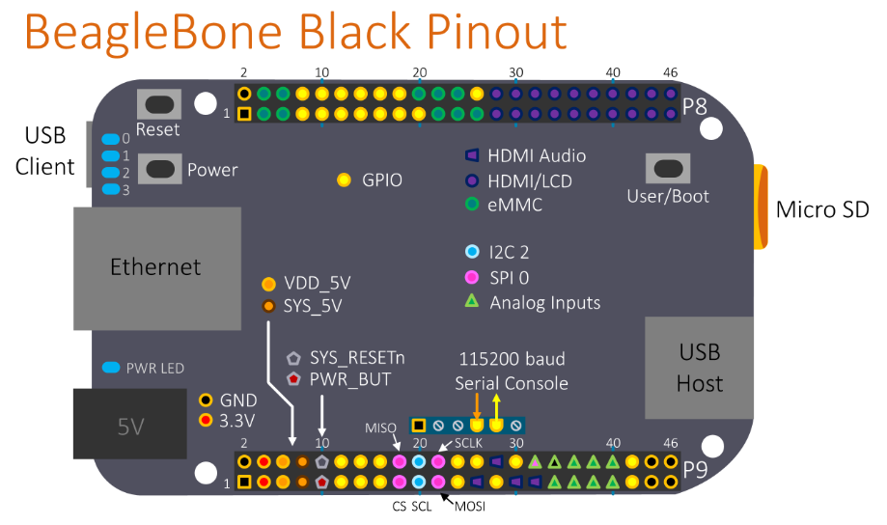
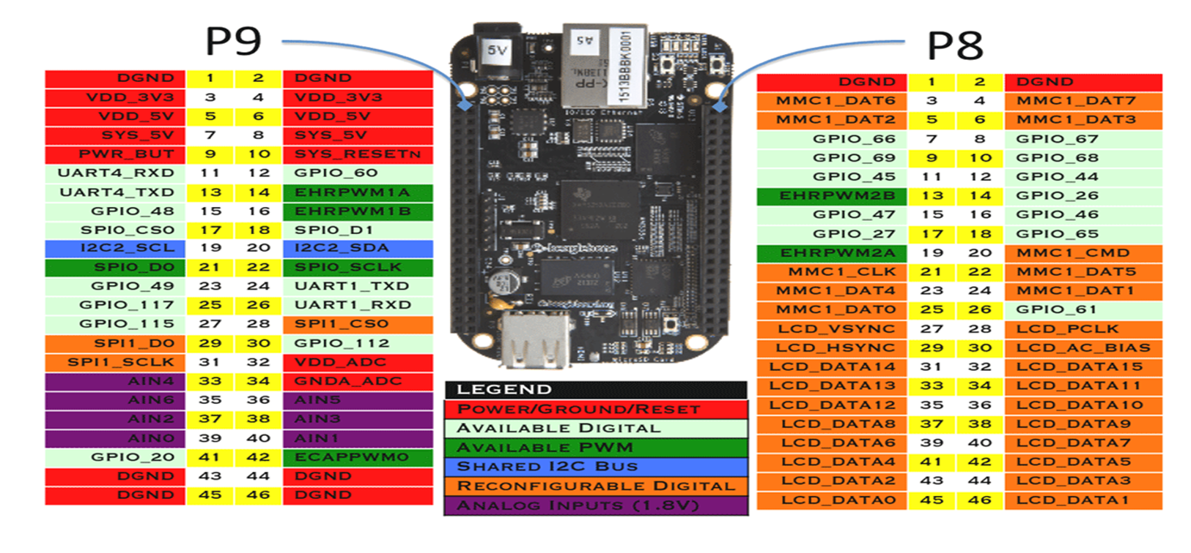
Beaglebone black pinout

Slide 9
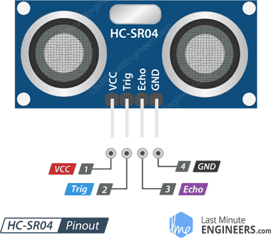
Ultrasonic sensors
In this project ultrasonic sensors are used to detect the presence of a person.
Operating voltage of the sensor is 5V.
Operating current of the sensor is 15mA
The maximum range is 4m and minimum range is 2cm for this sensor.
VCC is the power supply for the sensor which we will connect with the SYS_5v pin on the BBB.
GND should be connected to the ground pin of BBB
Trig (trigger) pin is used to trigger the ultrasonic sound pulses.
Echo pin produces a pulse when the reflected signal is received. The length of the pulse is proportional to the time it took for the transmitted signal to be detected.

Slide 10
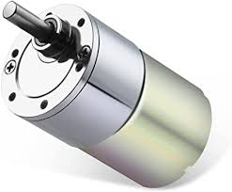
DC Motor
In this project two 12V 10RPM DC motors are used.
One motor is used to control the entry door and the second motor is for exit door.
The motor rotates in clockwise and anticlockwise direction for opening and closing of doors.

Slide 11
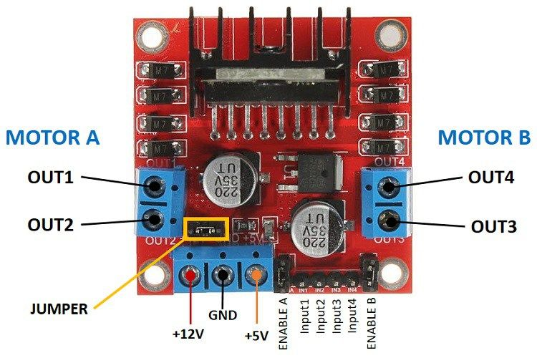
Motor driver (l298n)
L298N motor driver is used to run both motors in this project.
It is a dual motor driver so both the motors can operate at the same time.
Its operating voltage is 7-12V and maximum supply voltage is upto 46V.

Slide 12
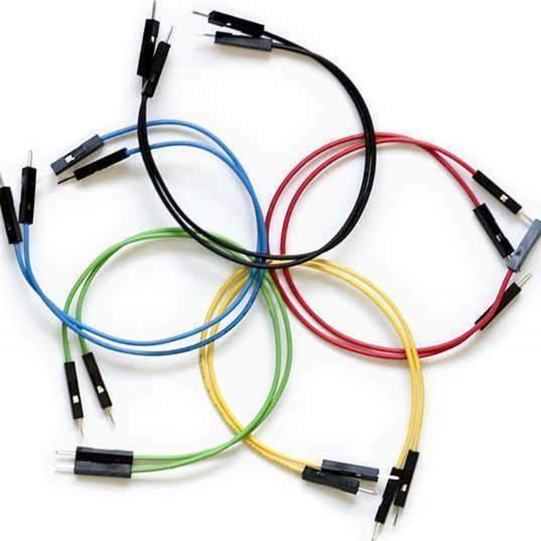
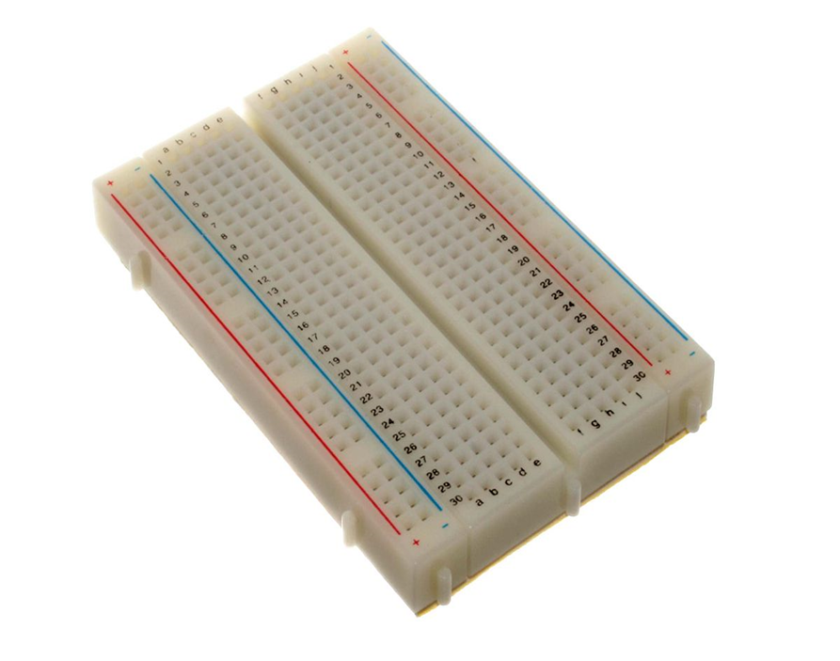
Jumper wires and breadboard
Breadboard and jumper wires are used to make connections between components and beaglebone black.

Slide 13

Supporting software

Slide 14
putty
PuTTY is an SSH and telnet client, developed originally for the Windows platform.
It is an open-source software that was originally written for Microsoft Windows, but it has been ported to various other operating systems.
it comes bundled with command-line SCP and SFTP clients, called "pscp" and "psftp" respectively.

Slide 15
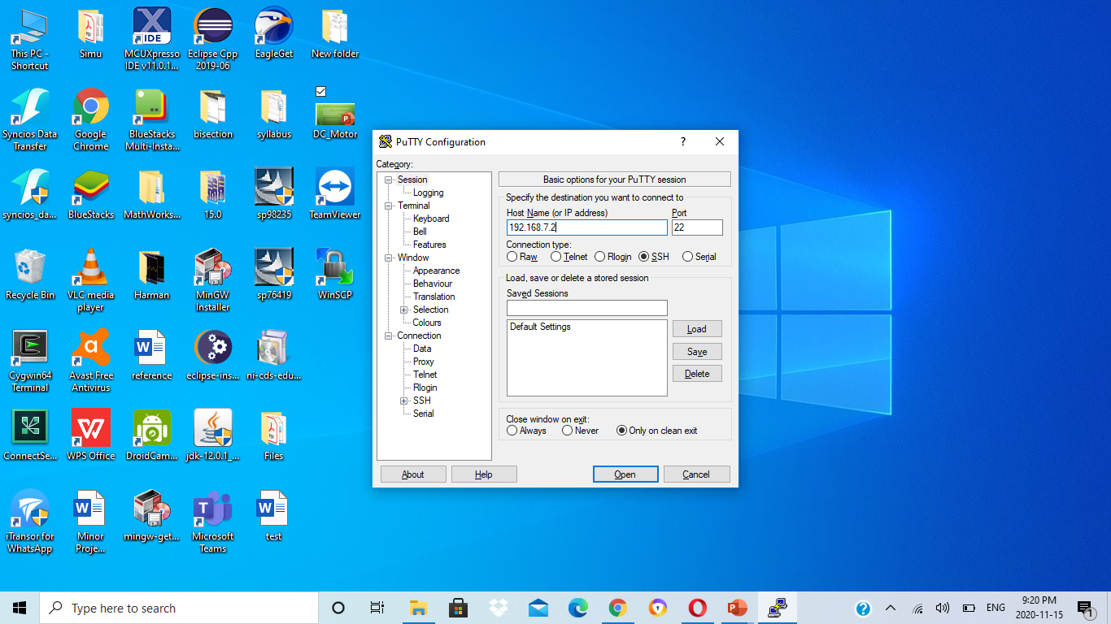

Slide 16
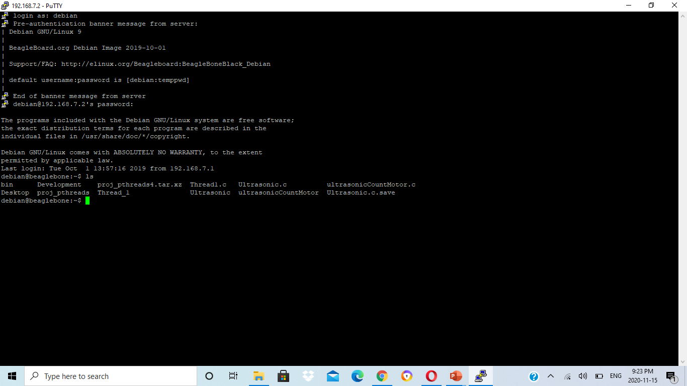

Slide 17
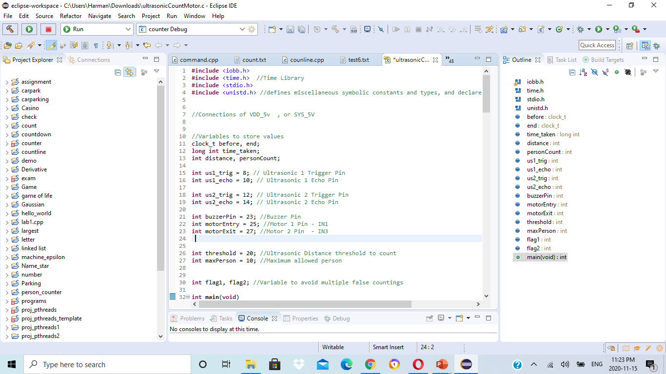
Eclipse ide
Eclipse IDE is used to write the code for this interfacing.
The programming is done in C language.

Slide 18
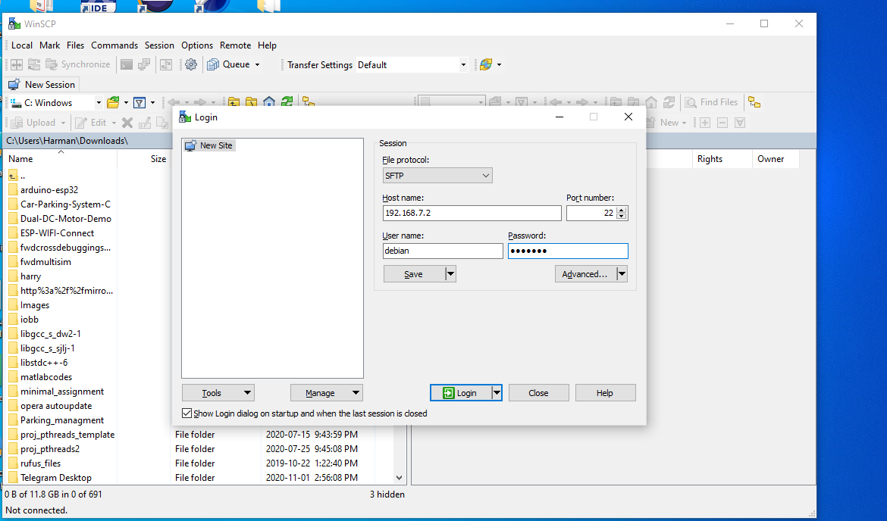
winscp
WinSCP (Windows Secure Copy) is a popular free and open-source SFTP, FTP, WebDAV, Amazon S3 and SCP client for Microsoft Windows.
Its main function is secure file transfer between a local and a remote computer.
For secure transfers, it uses Secure Shell (SSH) and supports the SCP protocol in addition to SFTP.
It provides limited remote command execution and scripting capabilities.
WinSCP is based on the implementation of the SSH protocol from PuTTY and FTP protocol from FileZilla.

Slide 19
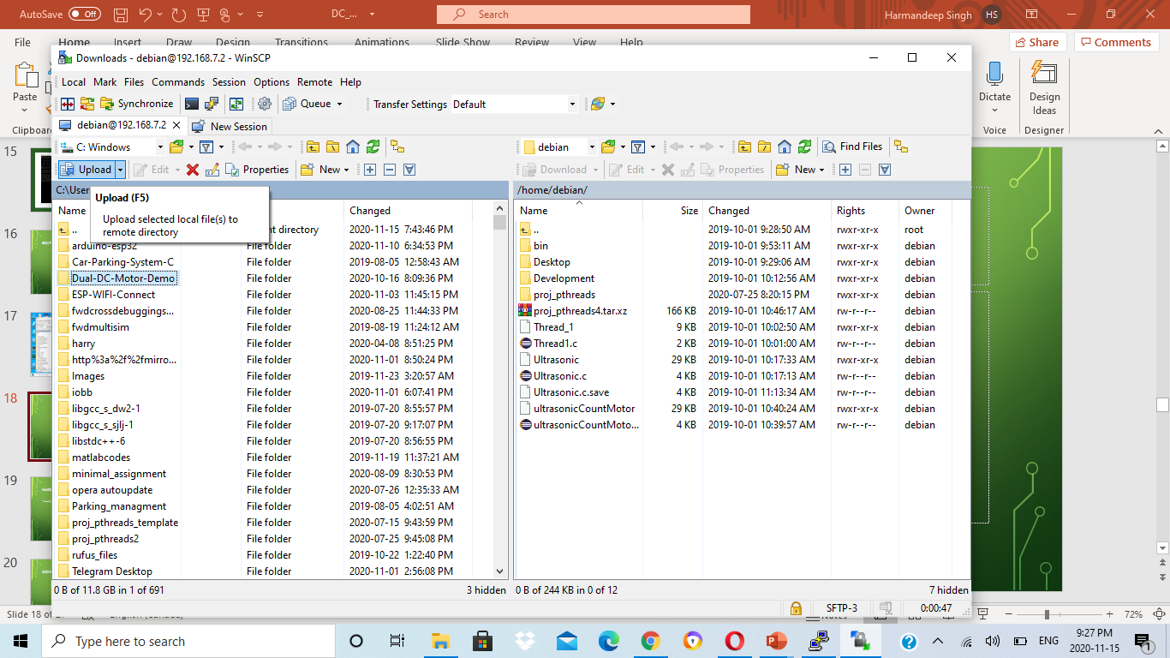

Slide 20
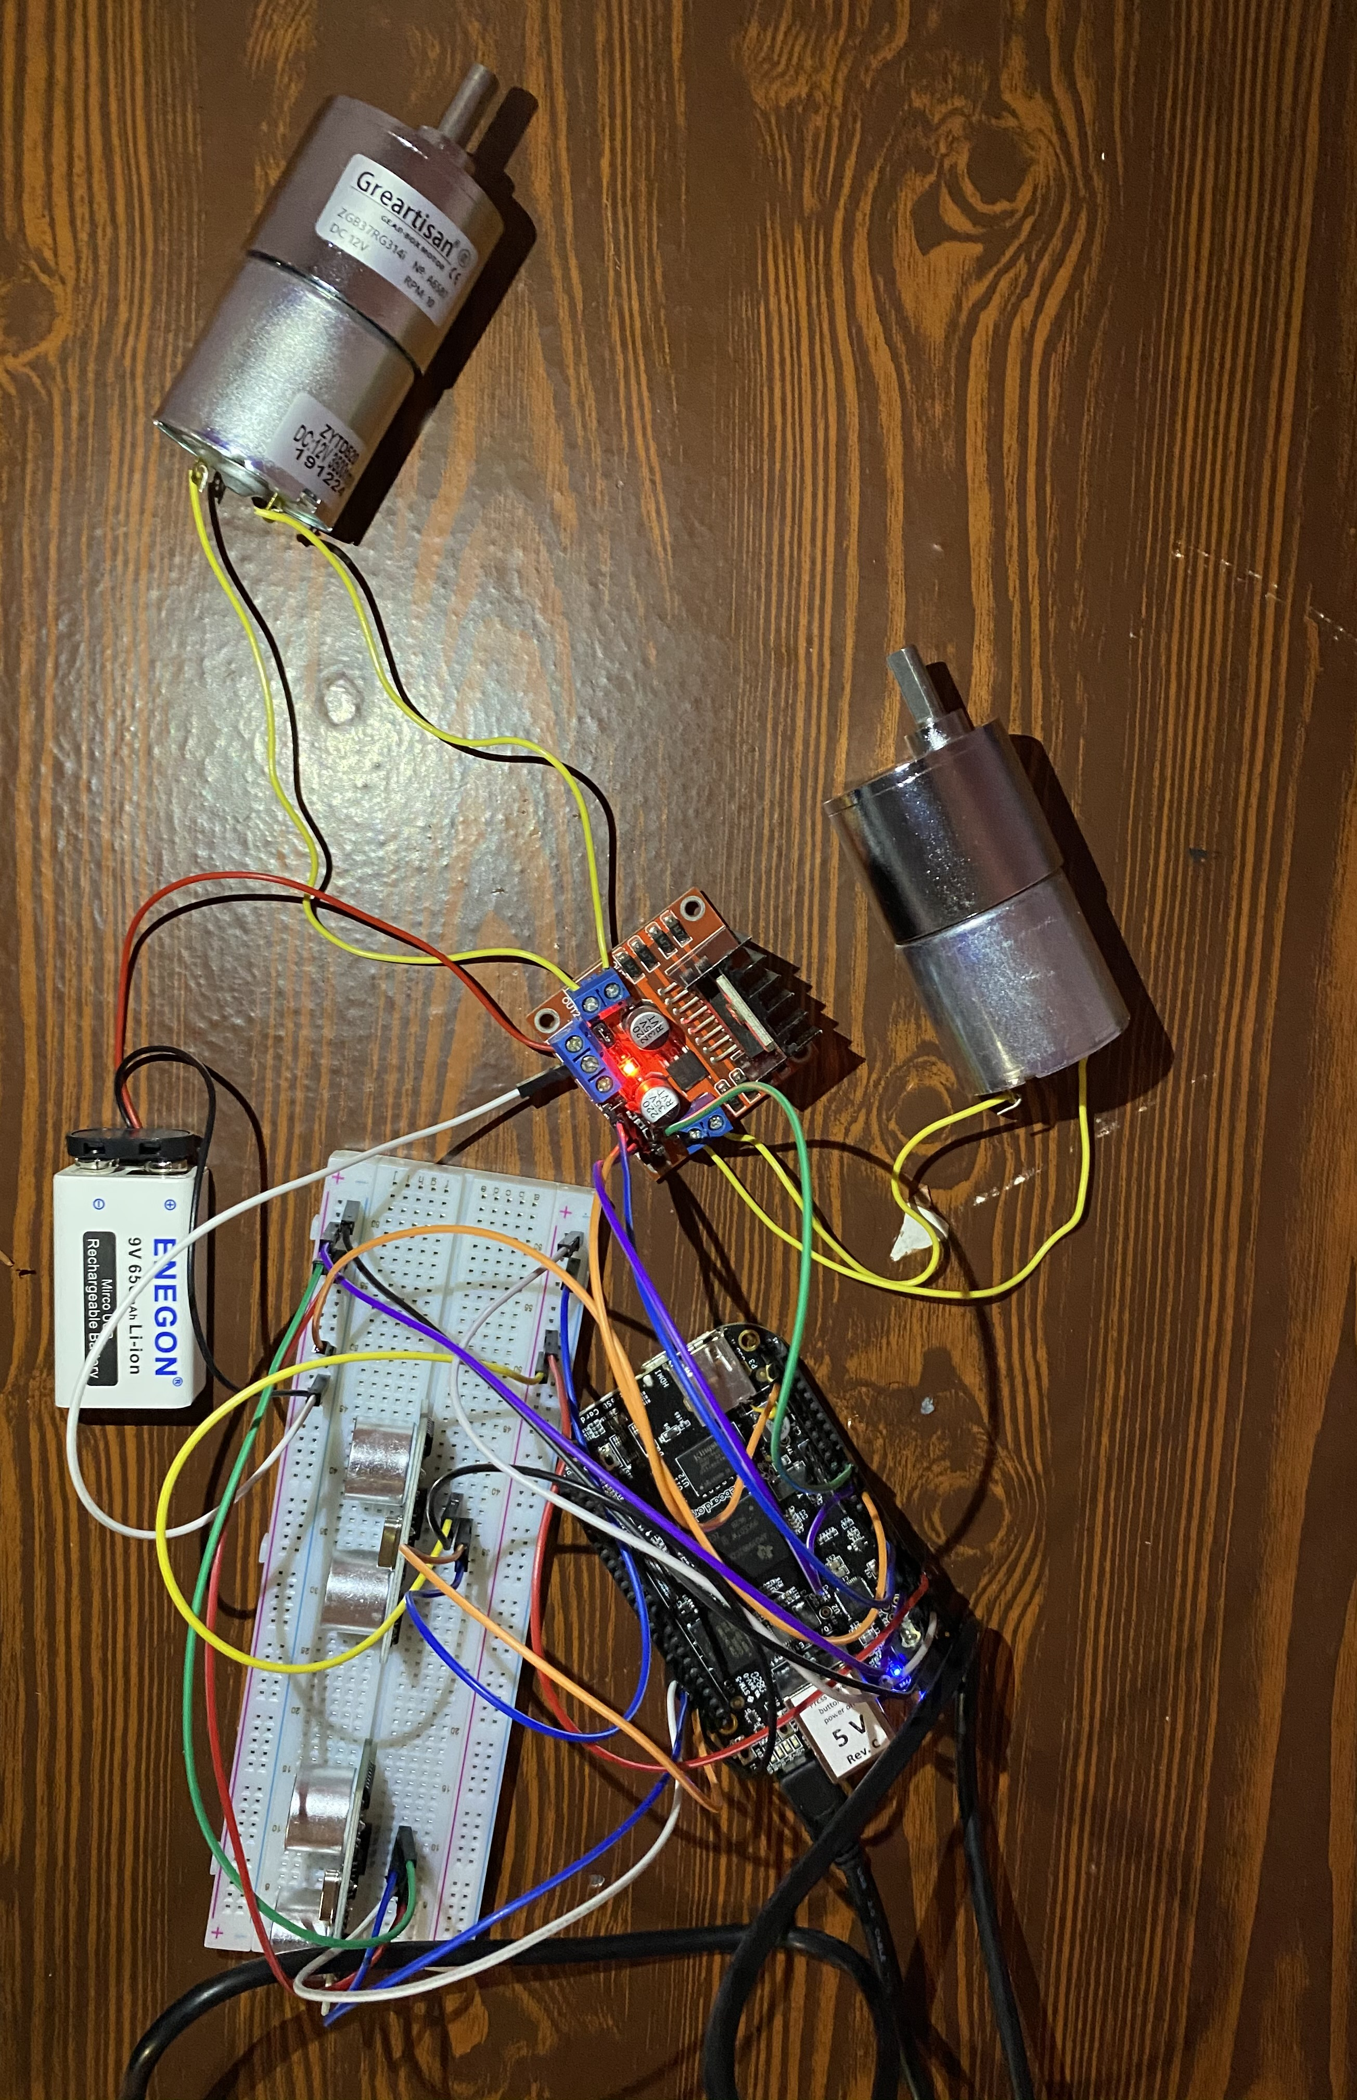
Hardware Setup

Slide 21
Description of connections
Connecting Ultrasonic sensor 1 with BBB
Connect ground pin with P9.1(GND) of BBB
Connect VCC pin with P9.7(SYS_5V) of BBB
Connect Trigger pin with P8.8(GPIO_67) of BBB
Connect Echo pin with P8.10(GPIO_68) of BBB
Connecting ultrasonic sensor 2 with BBB
Connect ground pin with P9.2(GND) of BBB
Connect VCC pin with P9.8(SYS_5V) of BBB
Connect Trigger pin with P8.12(GPIO_44) of BBB
Connect Echo pin with P8.14(GPIO_26) of BBB

Slide 22
Connecting motors and motor driver with Beaglebone black
Connect Motor1 terminals with Out1 and Out2 of L298N
Connect Motor2 terminals with Out3 and Out4 of L298N
Connect IN1 pin with P9.15(GPIO_48) of BBB
Connect IN2 pin with P9.23(GPIO_49) of BBB
Connect IN3 pin with P9.25(GPIO_117) of BBB
Connect IN4 pin with P9.27(GPIO_115) of BBB
Connect VCC and GND of L298N with positive and negative terminals of battery
Connect GND of L298N with P9.46(GND) of BBB

Slide 23
Working
There are two ultrasonic sensors and two DC motors used for both entry and exit.
Both sensors continuously measures the distance of obstacles in front of them.
Range of ultrasonic sensors is already set in the code.
If a person comes inside the range of sensor 1 it will be counted as a person entered inside and the motor 1 will then open the entry gate for that person to allow access and then close it after some time.
If a person comes inside the range of sensor 2 it will be counted as person going out and the motor 2 will then open the exit gate for that person and then close it after some time.
A limit of maximum person is set in code, if already maximum persons are inside then other people have to wait outside until someone exits.

Slide 24

Software part

Slide 25
Installing the iobb library
The following steps were performed to install this library in BBB
mkdir development
cd development
git clone https://github.com/shabaz123/iobb.git
cd iobb
make
make install
Sometimes make install command may give permission denied error then to resolve this allow root permission by using the command sudo make install

Slide 26
Using the iobb library
To use this library include this header file into your C code : #include<iobb.h>
To initialize the library : iolib_init();
To set a GPIO pin to become an input or output, use these commands (the first digit is 8 or 9 to represent the connector P8 or P9, and the second digit is the physical pin number on the connector):
iolib_setdir(8, 12, DigitalIn);
iolib_setdir(9, 12, DigitalOut);
At the end of the program, the library resources are freed up using: iolib_free();

Slide 27
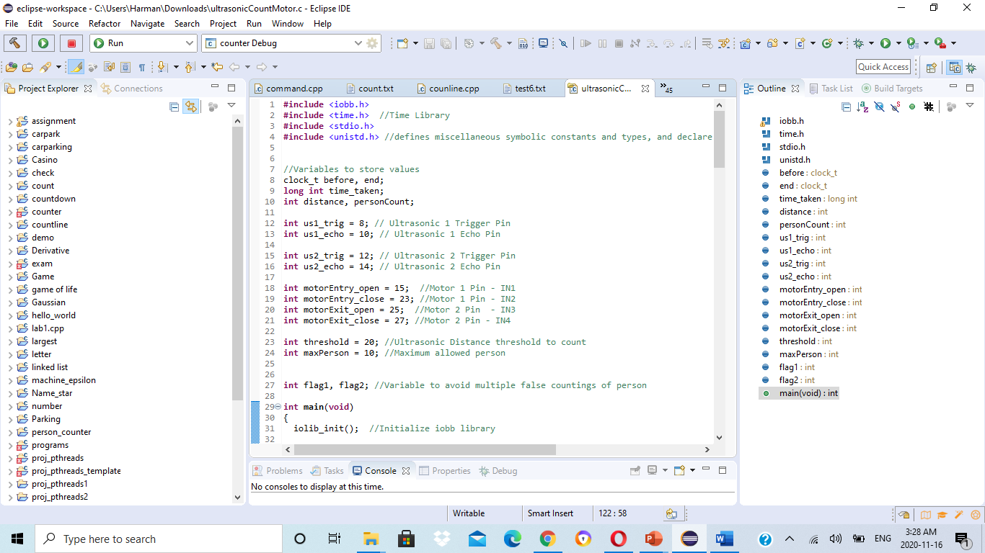
Overview of the code

Slide 28
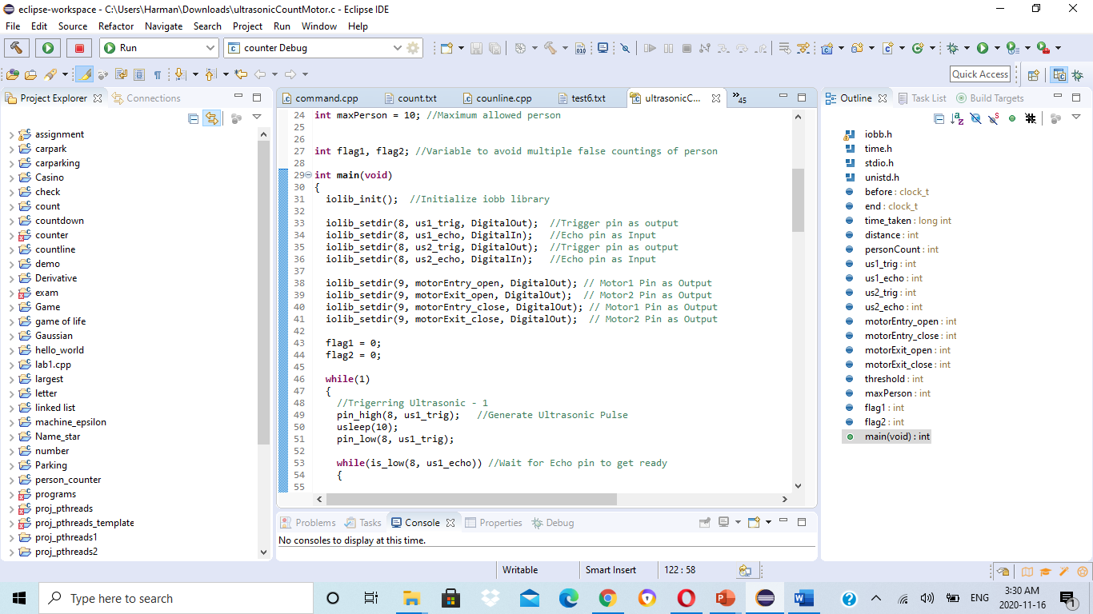

Slide 29
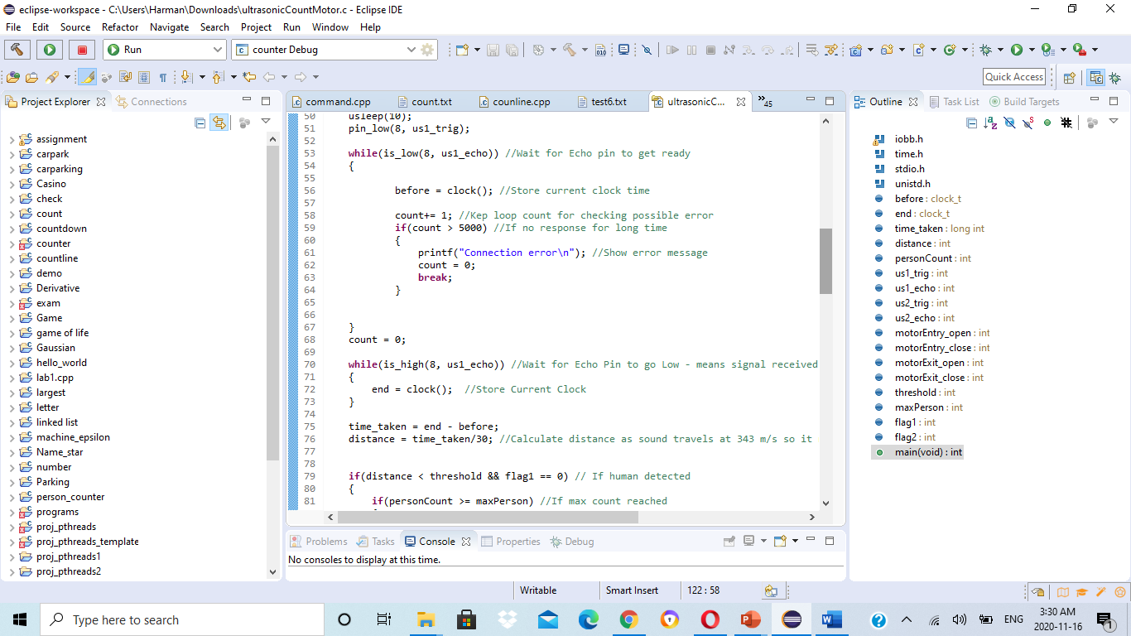

Slide 30
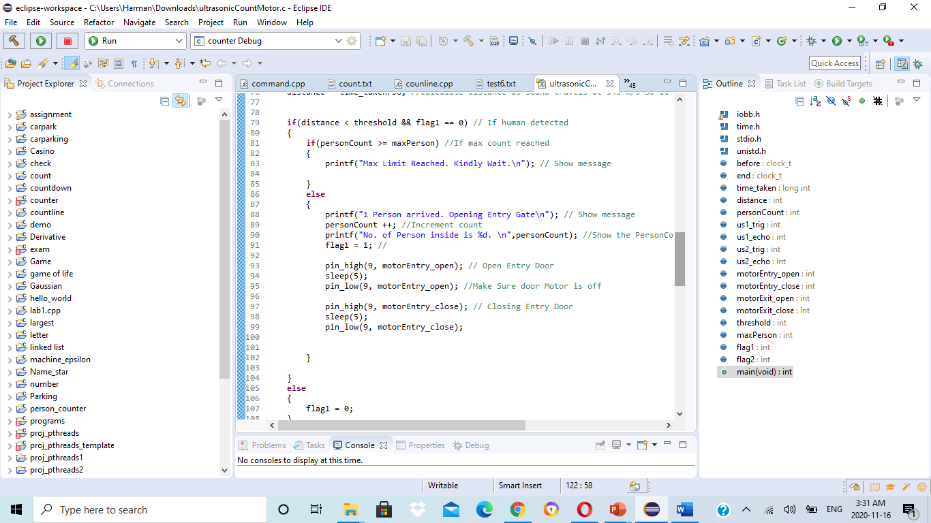

Slide 31
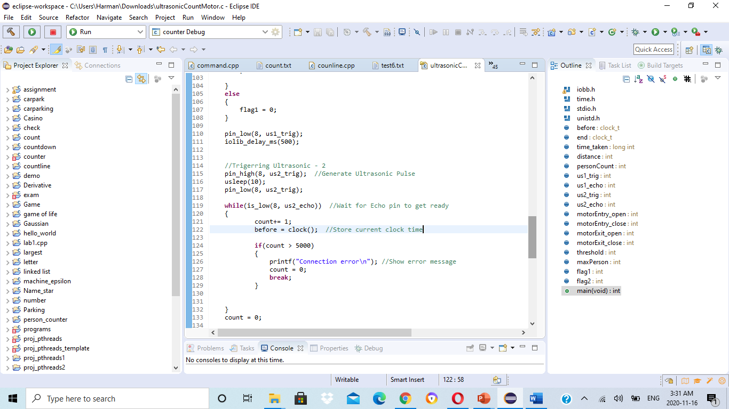

Slide 32
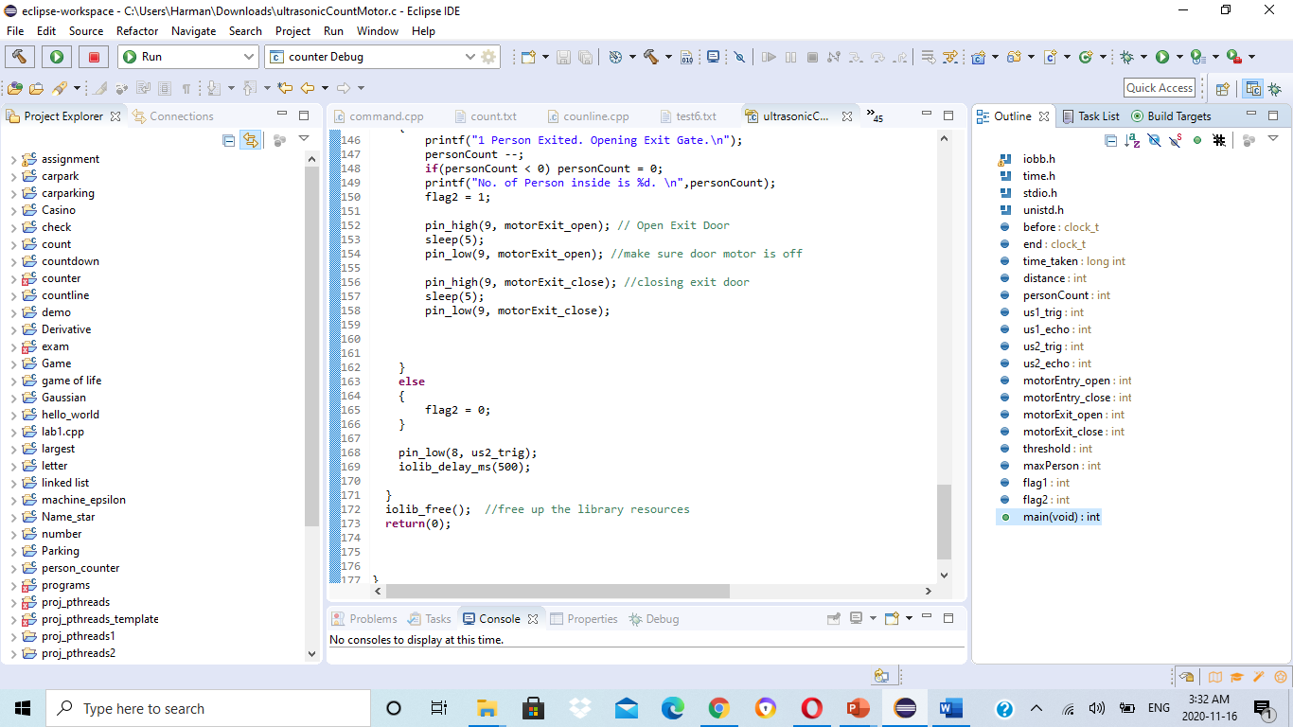

Slide 33
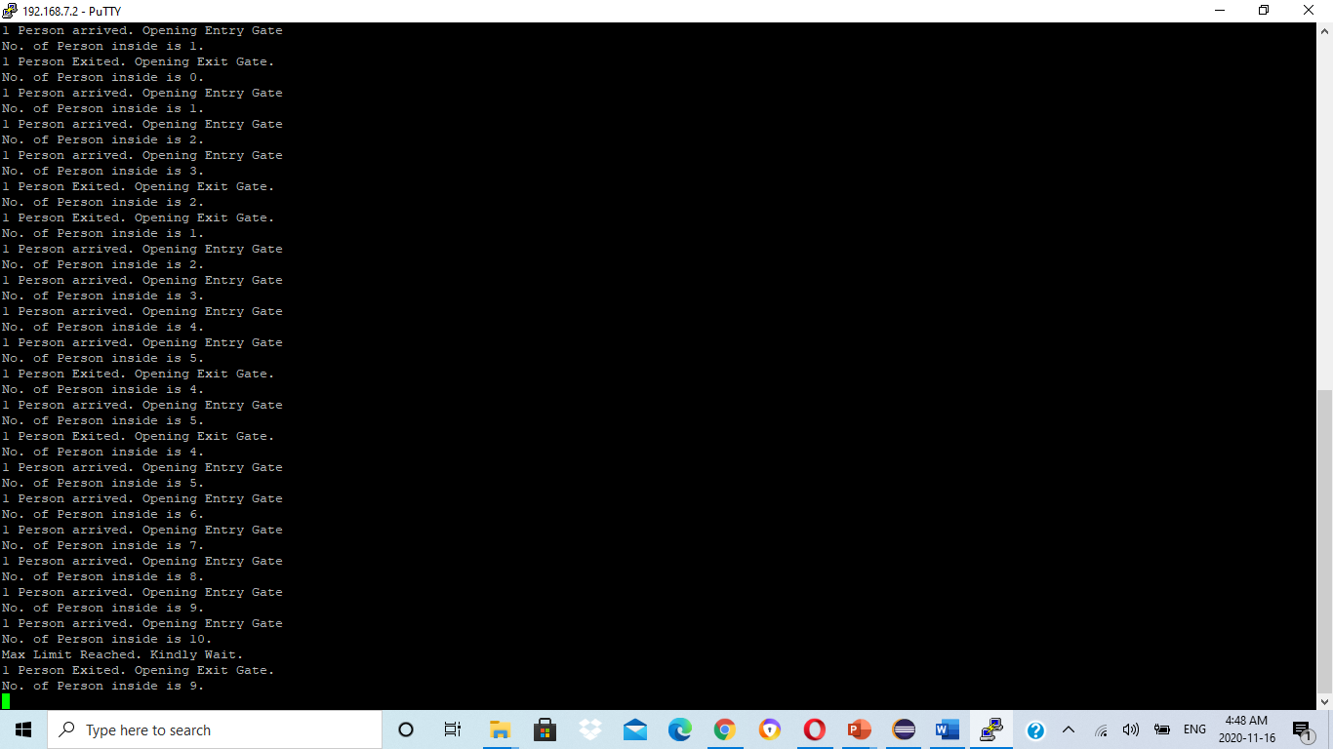
Results

Slide 34
conclusion
In this presentation interfacing of DC motor with Beaglebone Black has been discussed.
Ultrasonic sensors are used to detect the person at entry and exit points.
DC motors are used to control the entry and exit doors.

Slide 35
REfERENCES
shabaz. (2019, August 14). BeagleBone Black (BBB) and PocketBeagle I/O (GPIO), SPI and I2C Library for C – 2019 Edition. Retrieved from element14: https://www.element14.com/community/community/designcenter/single-board-computers/next-genbeaglebone/blog/2019/08/15/beaglebone-black-bbb-io-gpio-spi-and-i2c-library-for-c-2019-edition
WinSCP Review and Download. (n.d.). ssh.com.Retrieved from:https://www.ssh.com/ssh/winscp/
https://github.com/shabaz123/iobb
PuTTY: a free SSH and Telnet client.(n.d.) Retrieved from https://www.chiark.greenend.org.uk/~sgtatham/putty/
http://www.handsontec.com/dataspecs/L298N%20Motor%20Driver.pdf
O'Reilly. (n.d.). Chapter 4. Motors. Retrieved from https://www.oreilly.com/library/view/beaglebone-cookbook/9781491915660/ch04.html

Slide 36

THANK YOU

